Slide 1
GAMES103: Intro to Physics-Based Animation
Physics-Based Cloth Simulation
Huamin Wang
Nov 2021

Slide 2
Topics for the Day
A Mass-Spring System
Explicit Integration
Implicit Integration
Bending and Locking Issues
Shape matching

Slide 3
A Mass Spring System

Slide 4
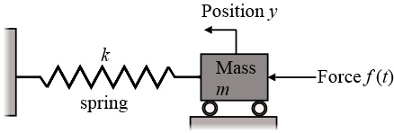
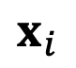
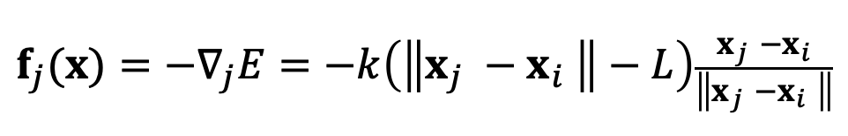
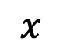
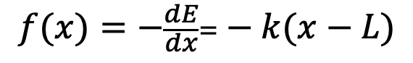
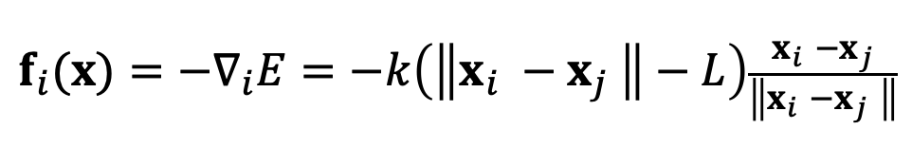
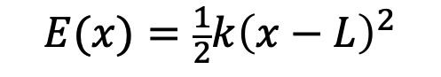
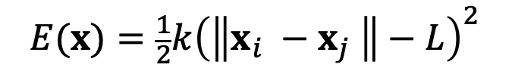
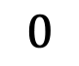
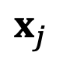
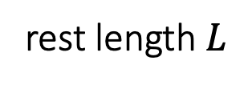

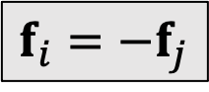
An Ideal Spring
An ideal spring satisfies Hooke’s law: the spring force tries to restore the rest length.
$$x_{j}$$
rest length $L$
$$f_{i}=−f_{j}$$
$$0$$
$$x$$
rest length $L$
$$x_{i}$$
$$E(x)={\frac{1}{2}k\left(\left\|x_{i} −x_{j} \right\|−L\right)}^{2}$$
$$E(x)={\frac{1}{2}k\left(x−L\right)}^{2}$$
$$f_{i}(x)=−∇_{i}E=−k\left(\left\|x_{i} −x_{j} \right\|−L\right)\frac{x_{i} −x_{j}}{\left\|x_{i} −x_{j} \right\|}$$
$$f(x)=−\frac{dE}{dx}=−k(x−L)$$
$$f_{j}(x)=−∇_{j}E=−k\left(\left\|x_{j} −x_{i} \right\|−L\right)\frac{x_{j} −x_{i}}{\left\|x_{j} −x_{i} \right\|}$$
spring stiffness

Slide 5
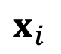
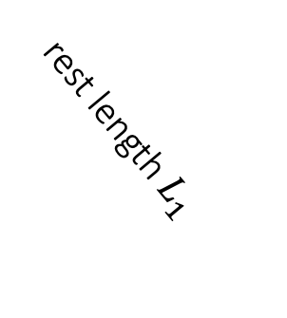

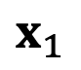
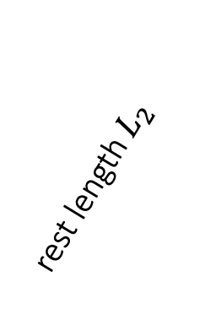
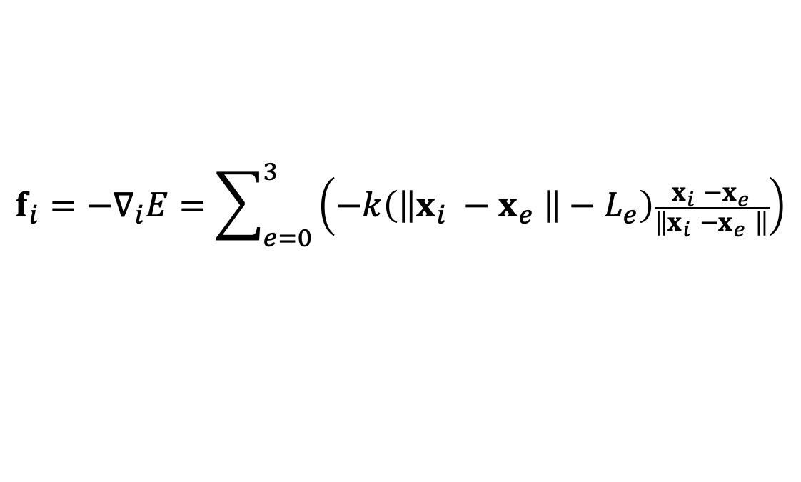
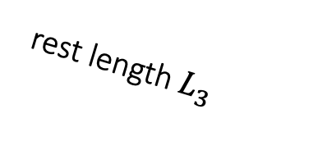
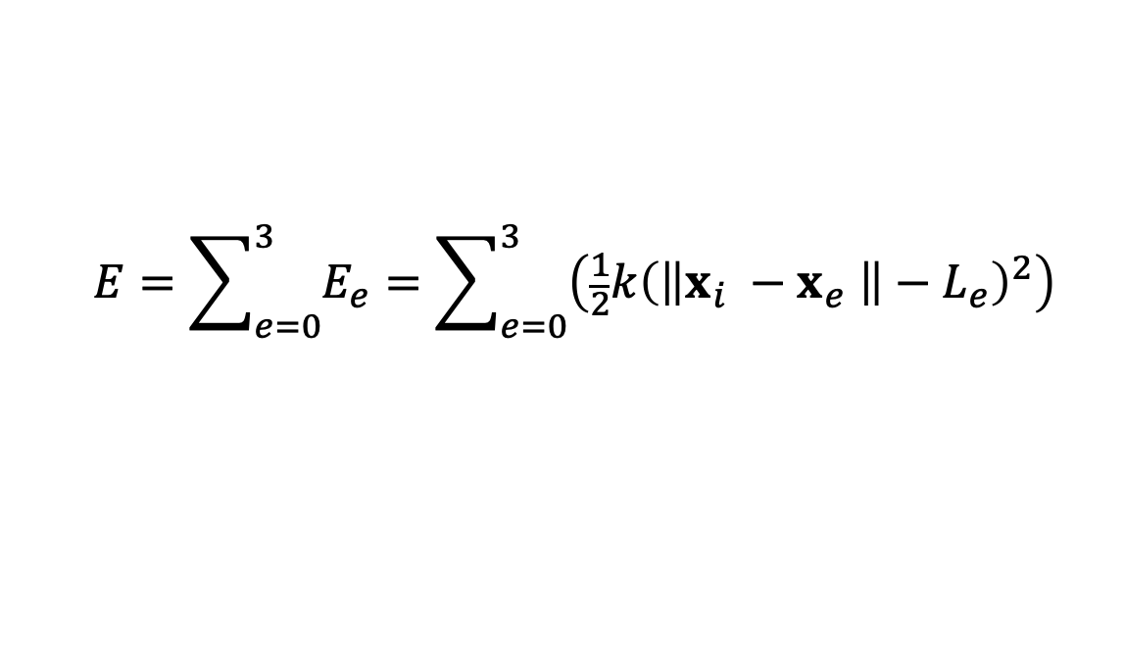
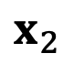
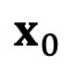
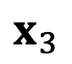
Multiple Springs
When there are many springs, the energies and the forces can be simply summed up.
$$x_{0}$$
rest length $L_{0}$
$$E=\sum_{e=0}^{3}{E_{e}}=\sum_{e=0}^{3}{\left({\frac{1}{2}k\left(\left\|x_{i} −x_{e} \right\|−L_{e}\right)}^{2}\right)}$$
$$x_{3}$$
rest length $L_{3}$
$$x_{i}$$
$$f_{i}=−∇_{i}E=\sum_{e=0}^{3}{\left(−k\left(\left\|x_{i} −x_{e} \right\|−L_{e}\right)\frac{x_{i} −x_{e}}{\left\|x_{i} −x_{e} \right\|}\right)}$$
rest length $L_{2}$
rest length $L_{1}$
$$x_{2}$$
$$x_{1}$$

Slide 6
Structured Spring Networks
Horizontal and vertical
Diagonal
Bending
A structured network
A simplified network

Slide 7
Unstructured Spring Networks
We can also turn an unstructured triangle mesh into a spring network for simulation.
Edges
Bending (every neighboring triangle pair)

Slide 8
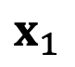

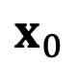
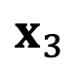
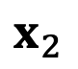
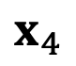
Triangle Mesh Representation
The basic representation of a triangle mesh uses vertex and triangle lists.
$$x_{1}$$
Vertex list: {$x_{0}$, $x_{1}$, $x_{2}$, $x_{3}$, $x_{4}$} (3D vectors)
$$x_{0}$$
Triangle 1
$$x_{2}$$
Triangle 0
Triangle list: {1, 2, 3, 0, 1, 3, 0, 3, 4} (index triples)
Triangle 2
Each triangle has three edges. But there are repeated ones.
$$x_{3}$$
$$x_{4}$$

Slide 9
Topological Construction
The key to topological construction is to sort triangle edge triples.
Each triple contains: edge vertex index 0, edge vertex index 1 and triangle index (index 0<index).
Triple list: {{1, 2, 0}, {2, 3, 0}, {1, 3, 0},
{0, 1, 1}, {1, 3, 1}, {0, 3, 1},
{0, 3, 2}, {3, 4, 2}, {0, 4, 2}}
$$x_{1}$$
$$x_{0}$$
Triangle 1
$$x_{2}$$
Triangle 0
Sorting
Sorted triple list: {{0, 1, 1}, {0, 3, 1}, {0, 3, 2}, {0, 4, 2}, {1, 2, 0}, {1, 3, 0}, {1, 3, 1}, {2, 3, 0}, {3, 4, 2}}
Triangle 2
Removal
Edge list: {{0, 1}, {0, 3}, {0, 4}, {1, 2}, {1, 3}, {2, 3}, {3, 4}}
$$x_{3}$$
$$x_{4}$$
Neighboring triangle list: {{1, 2}, {0, 1}} (for bending)

Slide 10
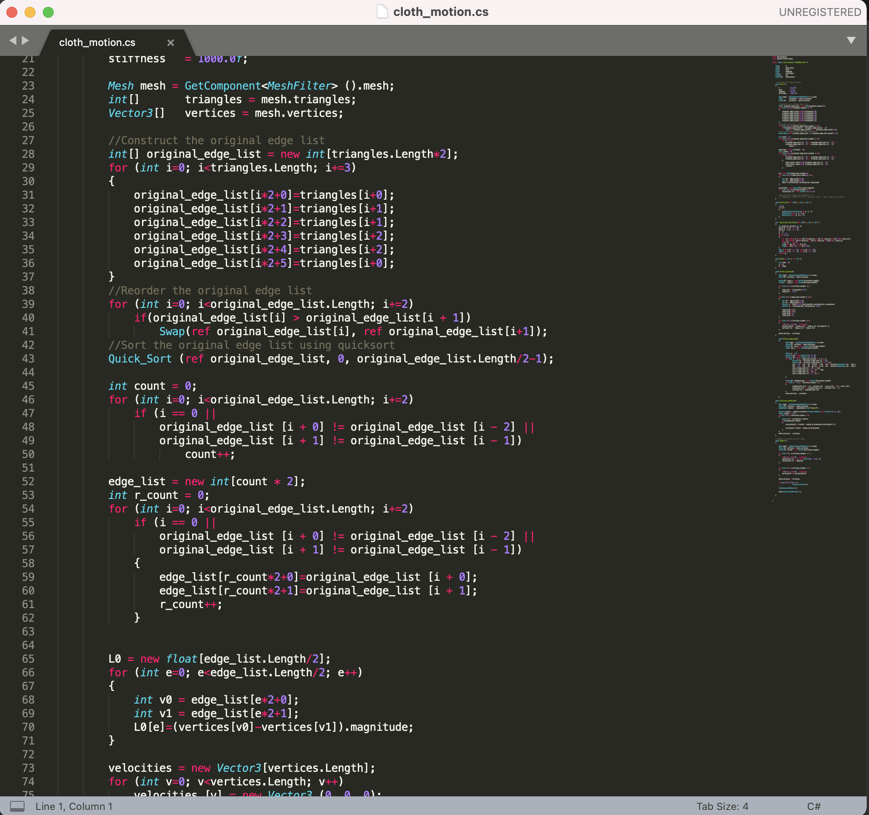
After-Class Reading
See lab assignment demo code for details.

Slide 11
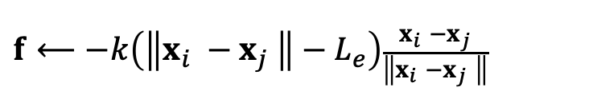
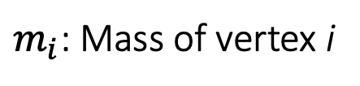
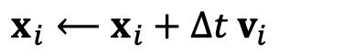
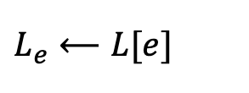

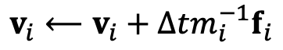
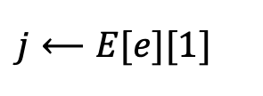
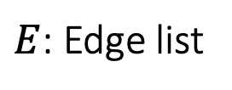
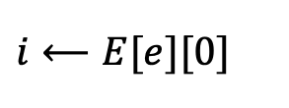
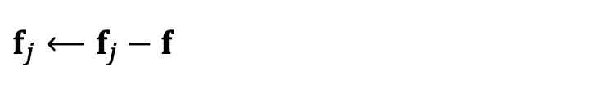

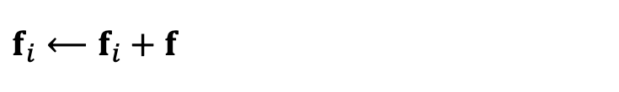
Explicit Integration of A Mass-Spring System
Compute Spring Forces
For every edge e
$$i⟵E[e][0]$$
A Particle System
For every vertex
$$j⟵E[e][1]$$
$f_{i}⟵Force\left(x_{i}, v_{i}\right)$
Done
$$L_{e}⟵L[e]$$
$$v_{i}⟵v_{i}+∆tm_{i}^{−1}f_{i}$$
$$f⟵−k\left(\left\|x_{i} −x_{j} \right\|−L_{e}\right)\frac{x_{i} −x_{j}}{\left\|x_{i} −x_{j} \right\|}$$
$x_{i}⟵x_{i}+∆t$ $v_{i}$
$$f_{i}⟵f_{i}+f$$
$$f_{j}⟵f_{j}−f$$
$E$: Edge list
$L$: Edge length list
$m_{i}$: Mass of vertex i

Slide 12
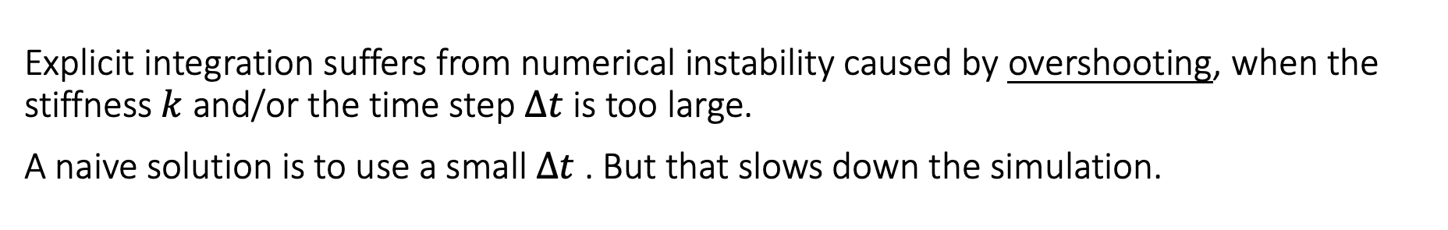
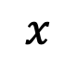
Explicit Integration of A Mass-Spring System
Explicit integration suffers from numerical instability caused by overshooting, when the stiffness $k$ and/or the time step $∆t$ is too large.
A naive solution is to use a small $∆t$ . But that slows down the simulation.
$$x$$
$$x$$

Slide 13
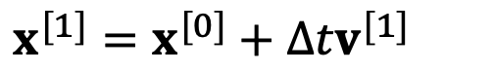
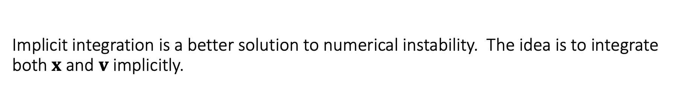
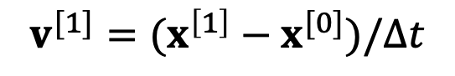
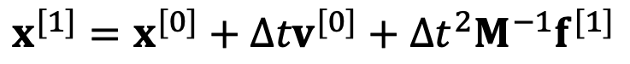
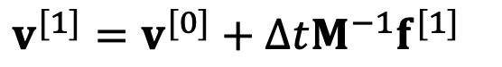
Implicit Integration
Implicit integration is a better solution to numerical instability. The idea is to integrate both $x$ and $v$ implicitly.
$v^{[1]}=v^{[0]}+{∆tM^{−1}f}^{[1]}$
$$x^{[1]}=x^{[0]}+{∆tv}^{[0]}+{∆t^{2}M^{−1}f}^{[1]}$$
or
$x^{[1]}=x^{[0]}+{∆tv}^{[1]}$
$$v^{[1]}=(x^{\left[1\right]}−x^{[0]})/∆t$$
Assuming that $f$is holonomic, i.e., depending on $x$ only, our question is how to solve:
$$x^{[1]}=x^{[0]}+{∆tv}^{[0]}+∆t^{2}M^{−1}f(x^{[1]})$$

Slide 14
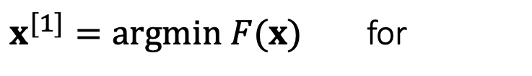
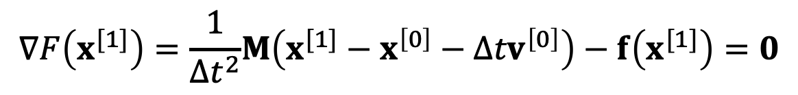

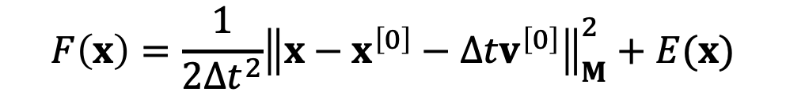
Implicit Integration
These two are equivalent:
$$x^{[1]}=x^{[0]}+{∆tv}^{[0]}+∆t^{2}M^{−1}f(x^{[1]})$$
$${\left\|x\right\|}_{M}^{2}=x^{T}Mx$$
$$F\left(x\right)=\frac{1}{2∆t^{2}}{\left\|x−x^{\left[0\right]}−{∆tv}^{\left[0\right]}\right\|}_{M}^{2}+E(x)$$
$x^{[1]}=argmin F(x)$ for
This is because:
$$∇F\left(x^{[1]}\right)=\frac{1}{∆t^{2}}M\left(x^{[1]}−x^{\left[0\right]}−{∆tv}^{\left[0\right]}\right)−f\left(x^{[1]}\right)=0$$
$$x^{[1]}−x^{\left[0\right]}−{∆tv}^{\left[0\right]}−∆t^{2}M^{−1}f\left(x^{[1]}\right)=0$$
Note that this is applicable to every system, not just a mass-spring system.

Slide 15
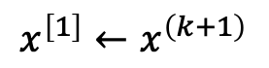
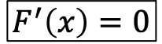







Newton-Raphson Method
The Newton-Raphson method, commonly known as Newton’s method, solves the optimization problem: $x^{[1]}=argmin F\left(x\right)$. ($F\left(x\right)$ is Lipschitz continuous.)
Given a current $x^{(k)}$, we approximate our goal by:
$$0=F′\left(x\right)≈F′\left(x^{\left(k\right)}\right)+F′′\left(x^{(k)}\right)\left(x−x^{(k)}\right)$$
Newton’s Method
$$F(x)$$
Initialize $x^{\left(0\right)}$
For $k=0…K$
$$∆x←−{\left(F^{′′}\left(x^{\left(k\right)}\right)\right)}^{−1}F′\left(x^{\left(k\right)}\right)$$
$$x^{\left(k+1\right)}←x^{\left(k\right)}+∆x$$
If $|∆x|$ is small then break
$$x^{\left[1\right]}←x^{\left(k+1\right)}$$
$$F^{′}\left(x\right)=0$$
$$x$$

Slide 16




Newton-Raphson Method
Newton’s method finds an extremum, but it can be a minimum or maximum.
$$F(x)$$
At a minimum $x^{∗}$, $F^{′′}\left(x^{∗}\right)>0$.
At a maximum $x^{∗}$, $F^{′′}\left(x^{∗}\right)<0$.
If $F^{′′}\left(x\right)>0$ is everywhere, $F(x)$ has no maximum. => $F(x)$ has only one minimum.
$$F^{′}\left(x^{∗}\right)=0$$
$$x$$

Slide 17







Newton-Raphson Method
Now we can apply Newton’s method to: $x^{[1]}=argmin F\left(x\right)$.
Given a current $x^{(k)}$, we approximate our goal by:
$0=∇F\left(x\right)≈∇F\left(x^{(k)}\right)+\frac{∂F^{2}\left(x^{(k)}\right)}{∂x^{2}}\left(x−x^{(k)}\right)$
Newton’s Method
Initialize $x^{\left(0\right)}$
For $k=0…K$
$$∆x←−{\left(\frac{∂F^{2}\left(x^{(k)}\right)}{∂x^{2}}\right)}^{−1}∇F\left(x^{(k)}\right)$$
$$x^{\left(k+1\right)}←x^{\left(k\right)}+∆x$$
If $\left\|∆x\right\|$ is small then break
$$x^{\left[1\right]}←x^{\left(k+1\right)}$$

Slide 18








Simulation by Newton’s Method
$$F\left(x\right)=\frac{1}{2∆t^{2}}{\left\|x−x^{\left[0\right]}−{∆tv}^{\left[0\right]}\right\|}_{M}^{2}+E(x)$$
Specifically to simulation, we have:
$$∇F\left(x^{(k)}\right)=\frac{1}{∆t^{2}}M\left(x^{(k)}−x^{\left[0\right]}−{∆tv}^{\left[0\right]}\right)−f\left(x^{(k)}\right)$$
$$\frac{∂^{2}F\left(x^{(k)}\right)}{∂x^{2}}=\frac{1}{∆t^{2}}M+H\left(x^{\left(k\right)}\right)$$
Initialize $x^{\left(0\right)}$, often as $x^{\left[0\right]}$ or $x^{\left[0\right]}$ $+{∆tv}^{\left[0\right]}$
For $k=0…K$
$$\left(\frac{1}{∆t^{2}}M+H\left(x^{\left(k\right)}\right)\right)∆x=− \frac{1}{∆t^{2}}M\left({x^{\left(k\right)}−x}^{\left[0\right]}−{∆tv}^{\left[0\right]}\right)+f\left(x^{\left(k\right)}\right)$$
Solve
$$x^{\left(k+1\right)}←x^{\left(k\right)}+∆x$$
If $\left\|∆x\right\|$ is small then break
$$x^{\left[1\right]}←x^{\left(k+1\right)}$$
$v^{\left[1\right]}←\left(x^{\left[1\right]}−x^{\left[0\right]}\right)/$ $∆t$

Slide 19





Spring Hessian
According to Lecture 2, Page 48,
$H\left(x\right)=\sum_{e=\{i,j\}}{\left[\begin{matrix} & & & \\ & \frac{∂^{2}E}{{∂x}_{i}^{2}} & \frac{∂^{2}E}{∂x_{i}∂x_{j}} & \\ & \frac{∂^{2}E}{∂x_{i}∂x_{j}} & \frac{∂^{2}E}{{∂x}_{j}^{2}} & \\ & & & \end{matrix} \right]}=\sum_{e=\{i,j\}}{\left[\begin{matrix} & & & \\ & H_{e} & −H_{e} & \\ & −H_{e} & H_{e} & \\ & & & \end{matrix}\right]}\left[\right]$
$H_{e}=$ $k\frac{x_{ij}x_{ij}^{T}}{{\left\|x_{ij}\right\|}^{2}}+k\left(1−\frac{L}{\left\|x_{ij}\right\|}\right)\left(I−\frac{x_{ij}x_{ij}^{T}}{{\left\|x_{ij}\right\|}^{2}}\right)$
s.p.d.
negative if $\left\|x_{ij}\right\|<L_{e}$
s.p.d.
This is because for any $x_{ij}$, $v≠0$,
$$v^{T}\frac{x_{ij}{x_{ij}}^{T}}{{\left\|x_{ij}\right\|}^{2}}v={\left\|\frac{{x_{ij}}^{T}v}{\left\|x_{ij}\right\|}\right\|}^{2}>0$$
$$v^{T}\left(I−\frac{x_{ij}{x_{ij}}^{T}}{{\left\|x_{ij}\right\|}^{2}}\right)v=\frac{{\left\|x_{ij}\right\|}^{2}{\left\|v\right\|}^{2}−{\left\|{x_{ij}}^{T}v\right\|}^{2}}{{\left\|x_{ij}\right\|}^{2}}≥0$$

Slide 20

Spring Hessian
When a spring is stretched, $H_{e}$ is s.p.d.; but when it’s compressed, $H_{e}$ may not be s.p.d.
As a result, $H\left(x\right)$may not be s.p.d. (Lecture 2, Page 36).
$A$may not be s.p.d. either.
$$A=\frac{1}{∆t^{2}}M+H\left(x\right)=\frac{1}{∆t^{2}}M+\sum_{e=\{i,j\}}{\left[\begin{matrix}⋱ & ⋮ & ⋮ & ⋰ \\ & H_{e} & −H_{e} & \\ & −H_{e} & H_{e} & \\ ⋰ & & & ⋱\end{matrix}\right]}$$
s.p.d.
May not be s.p.d.

Slide 21



Positive Definiteness of Hessian
$$F(x)$$
As before, if $∂^{2}F/∂x^{2}$ is positive definite everywhere, $F(x)$ has no maximum but only one minimum.
This is a sufficient but not necessary condition.
$$x$$

Slide 22
Positive Definiteness of Hessian
When a spring is compressed, the spring Hessian may not be positive definite. This means there can be multiple local minima (outcomes).
Outcome 1
Outcome 2
Note: This issue occurs only in 2D and 3D. In 1D, $E(x)={\frac{1}{2}k\left(x−L\right)}^{2}$ and $E^{′′}\left(x\right)=k>0.$

Slide 23


Enforcement of Positive Definiteness
Nevertheless, some linear solvers can fail to work if the matrix $A$ in $A∆x=b$ is not positive definite.
One solution is to simply drop the ending term, when $\left\|x_{ij}\right\|<L_{e}$:
Other solutions exist. For example,
Choi and Ko. 2002. Stable But Responive Cloth. TOG (SIGGRAPH)
$$H_{e}= k\frac{x_{ij}x_{ij}^{T}}{{\left\|x_{ij}\right\|}^{2}}+k\left(1−\frac{L}{\left\|x_{ij}\right\|}\right)\left(I−\frac{x_{ij}x_{ij}^{T}}{{\left\|x_{ij}\right\|}^{2}}\right)$$

Slide 24







The Jacobi Method
We can use the Jacobi method to solve $A∆x=b$.
The Jacobi Method
$∆x$ $⟵0$
For $k=0…K$
$r$ $⟵b−A∆x$
Residual error
If $\left\|r\right\|<ε$ break
Convergence condition $ε$
$$∆x⟵∆x+αD^{−1}r$$
Update by $D$, the diagonal of $A$
The vanilla Jacobi method ($α=1$) has a tight convergence requirement on $A$, i.e., being diagonal dominant.
The use of $α$ allows the method to converget even when $A$ is positive definite only.

Slide 25

Linear Solvers – An Incomplete Summary
Intel MKL PARDISO
Direct Solvers (LU, LDLT, Cholesky, …)
One shot, expensive but worthy if you need exact solutions.
Little restriction on $A$
Mostly suitable on CPUs
Iterative Solvers
Expensive to solve exactly, but controllable
Convergence restriction on $A$, typically positive definiteness
Suitable on both CPUs and GPUs
Easy to implement
Accelerable: Chebyshev, Nesterov, Conjugate Gradient…

Slide 26














The Jacobi Method with Chebyshev Acceleration
We can use the accelerated Jacobi method to solve $A∆x=b$.
The Accelerated Jacobi Method
$∆x$ $⟵0$
$last_∆x$ $⟵0$
For $k=0…K$
$r$ $⟵b−A∆x$
If $\left\|r\right\|<ε$ break
$ρ (ρ<1)$ is the estimated spectral radius of the iterative matrix.
If $k=0$ $ω=1$
Else If $k=1$ $ω=2/(2−ρ^{2})$
Else $ω=4/(4−ρ^{2}ω)$
$$old_∆x⟵∆x$$
$$∆x⟵∆x+αD^{−1}r$$
$$∆x⟵ω∆x+(1−ω)last_∆x$$
$$last_∆x⟵old_∆x$$

Slide 27

After-Class Reading
Baraff and Witkin. 1998. Large Step in Cloth Simulation. SIGGRAPH.
One of the first papers using implicit integration.
The paper proposes to use only one Newton iteration, i.e., solving only one linear system. This practice is fast, but can fail to converge.

Slide 28
Bending and Locking Issues

Slide 29


The Bending Spring Issue
A bending spring offers little resistance when cloth is nearly planar, since its length barely changes.
$$x_{1}$$
$$x_{0}$$
$$x_{2}$$

Slide 30












A Dihedral Angle Model
A dihedral angle model defines bending forces as a function of $θ$: $f_{i}=f\left(θ\right)u_{i}$.
$$u_{4}$$
$$u_{3}$$
$$x_{4}$$
First, $u_{1}$ and $u_{2}$ should be in the normal directions $n_{1}$ and $n_{2}$.
Second, bending doesn’t stretch the edge, so $u_{4}−u_{3}$ should be orthogonal to the edge, i.e., in the span of $n_{1}$ and $n_{2}$.
Finally, $u_{1}+u_{2}+u_{3}+u_{4}=0$, which means $u_{3}$ and $u_{4}$ are in the span of $n_{1}$ and $n_{2}$.
$$x_{3}$$
$$n_{2}$$
$$n_{1}$$
$$θ$$
$$u_{2}$$
$$u_{1}$$
$$x_{2}$$
$$x_{1}$$

Slide 31







A Dihedral Angle Model
A dihedral angle model defines bending forces as a function of $θ$: $f_{i}=f\left(θ\right)u_{i}$.
Conclusion:
$$u_{4}$$
$$u_{3}$$
$$x_{4}$$
$$u_{1}=\left\|E\right\|\frac{N_{1}}{{\left\|N_{1}\right\|}^{2}}$$
$$u_{2}=\left\|E\right\|\frac{N_{2}}{{\left\|N_{2}\right\|}^{2}}$$
$$x_{3}$$
$$u_{3}=\frac{(x_{1}−x_{4})∙E}{\left\|E\right\|}\frac{N_{1}}{{\left\|N_{1}\right\|}^{2}}+\frac{(x_{2}−x_{4})∙E}{\left\|E\right\|}\frac{N_{2}}{{\left\|N_{2}\right\|}^{2}}$$
$$n_{2}$$
$$n_{1}$$
$$θ$$
$$u_{2}$$
$$u_{4}=−\frac{(x_{1}−x_{3})∙E}{\left\|E\right\|}\frac{N_{1}}{{\left\|N_{1}\right\|}^{2}}−\frac{(x_{2}−x_{3})∙E}{\left\|E\right\|}\frac{N_{2}}{{\left\|N_{2}\right\|}^{2}}$$
$$u_{1}$$
$N_{1}=(x_{1}−x_{3})×$ $(x_{1}−x_{4})$
$N_{2}=(x_{2}−x_{4})×$ $(x_{2}−x_{3})$
$$x_{2}$$
$$x_{1}$$
$$E=x_{4}−x_{3}$$

Slide 32


A Dihedral Angle Model
A dihedral angle model defines bending forces as a function of $θ$: $f_{i}=f\left(θ\right)u_{i}$.
$$u_{4}$$
Planar case:
$$u_{3}$$
$$x_{4}$$
$$f_{i}=k\frac{{\left\|E\right\|}^{2}}{\left\|N_{1}\right\|+\left\|N_{2}\right\|}\sin\left(\frac{π−θ}{2}\right)u_{i}$$
$$x_{3}$$
$$n_{2}$$
Non-planar case:
$$n_{1}$$
$$θ$$
$$u_{2}$$
$$f_{i}=k\frac{{\left\|E\right\|}^{2}}{\left\|N_{1}\right\|+\left\|N_{2}\right\|}\left(\sin\left(\frac{π−θ}{2}\right)−\sin\left(\frac{π−θ_{0}}{2}\right)\right)u_{i}$$
$$u_{1}$$
$$x_{2}$$
$$x_{1}$$

Slide 33

After-Class Reading
Bridson et al. 2003. Simulation of Clothing with Folds and Wrinkles. SCA.
Explicit integration.
Derivative is difficult to compute.

Slide 34















A Quadratic Bending Model
A quadratic bending model has two assumptions: 1) planar case; 2) little stretching.
$$x_{2}$$
$$E(x)=\frac{1}{2}\left[\begin{matrix}x_{0} & x_{1} & x_{2} & x_{3}\end{matrix}\right]Q\left[\begin{aligned}x_{0} \\ x_{1} \\ x_{2} \\ x_{3}\end{aligned}\right]$$
Area $A_{0}$
$$θ_{0}$$
$$θ_{1}$$
$q=$ $\left[\begin{aligned}\left({cotθ}_{1}+cotθ_{3}\right)I \\ \left({cotθ}_{0}+cotθ_{2}\right)I \\ \left({−cotθ}_{0}−cotθ_{1}\right)I \\ \left({−cotθ}_{2}−cotθ_{3}\right)I\end{aligned}\right]$
$$x_{0}$$
$$x_{1}$$
$$Q=\frac{3}{A_{0}+A_{1}}{qq}^{T}$$
$$θ_{2}$$
$$θ_{3}$$
Area $A_{1}$
$I$ is 3-by-3 identity.
It’s not hard to see that: $E(x)=\frac{3{\left\|q^{T}x\right\|}^{2}}{2(A_{0}+A_{1})}$. Also, $E(x)=0$ when the triangles are flat.
$$x_{3}$$

Slide 35


Pros and Cons of The Quadratic Bending Model
Easy to implement:
Compatible with implicit integration.
No longer valid if cloth stretches much.
Not suitable if the rest configuration is not planar.
Cubic shell model.
Projective dynamics model.
Details skipped here.
$f\left(x\right)=−∇E(x)=$ $−Q\left[\begin{aligned}x_{0} \\ x_{1} \\ x_{2} \\ x_{3}\end{aligned}\right]$
$H\left(x\right)=\frac{∂^{2}E(x)}{∂x^{2}}=$ $Q$

Slide 36

After-Class Reading
Bergou et al. 2006. A Quadratic Bending Model for Inextensible Surfaces. SCA.

Slide 37
The Locking Issue
So far we talked about the mass-spring model and other bending models, assuming cloth planar deformation and cloth bending deformation are independent.
Is it true? Think about a zero bending case. Can a simulator fold cloth freely?
folding line
folding line

Slide 38

The Locking Issue
The fundamental reason is due to a short of degrees of freedoms (DoFs).
For a manifold mesh, Euler’s formula says: #edges=3#vertices-3-#boundary_edges.
So if edges are all hard constraints, the DoFs are only: 3+ #boundary_edges.
English and Bridson. 2008. Animating Developable Surfaces Using Nonconforming Elements. SIGGRAPH.
(optional)

Slide 39
Shape Matching

Slide 40











Shape Matching
The basic idea is to define a quadratic energy based on the rotated reference element.
To do so, we split transformation into deformation + rotation.
$$x_{2}$$
$$x_{2}−x_{0}$$
$$r_{2}$$
Transformation Matrix $F$
$$r_{2}−r_{0}$$
$$x_{1}$$
$$F\left[\begin{matrix}r_{1}−r_{0} & r_{2}−r_{0}\end{matrix}\right]=\left[\begin{matrix}x_{1}−x_{0} & x_{2}−x_{0}\end{matrix}\right]$$
$$x_{1}−x_{0}$$
Therefore,
$$r_{0}$$
$$r_{1}−r_{0}$$
$$r_{1}$$
The 3D Space
The 2D Space
$$F=\left[\begin{matrix}x_{1}−x_{0} & x_{2}−x_{0}\end{matrix}\right]{\left[\begin{matrix}r_{1}−r_{0} & r_{2}−r_{0}\end{matrix}\right]}^{−1}$$
$$x_{0}$$

Slide 41











Shape Matching
The basic idea is to define a quadratic energy based on the rotated reference element.
To do so, we split transformation into deformation + rotation.
$$x_{2}$$
Transformation Matrix $F=U D V^{T}=\left(UV^{T}\right)(VDV^{T})$
$$3×2$$
$$2×2$$
$$2×2$$
$$3×2$$
$$2×2$$
$$x_{2}−x_{0}$$
$$r_{2}−r_{0}$$
$$x_{1}$$
Deformation by S= $VDV^{T}$
Rotation by R= $UV^{T}$
$$x_{1}−x_{0}$$
$$r_{1}−r_{0}$$
The 3D Space
The 2D Space
$$x_{0}$$
The 2D Space

Slide 42


Shape Matching
We can then define the quadratic energy as:
$$E\left(x\right)={\frac{1}{2}\left\|F−R \right\|}^{2}$$
($R$ is the rotation inside of $F$. This energy tries to penalize the existence of $S$.)
Assuming that $R$ is constant, this $E\left(x\right)$ becomes a quadratic function. We can then derive the force and the Hessian.
$$E\left(x\right) ={\frac{1}{2}\left\|\left[\begin{matrix}x_{1}−x_{0} & x_{2}−x_{0}\end{matrix}\right]{\left[\begin{matrix}r_{1}−r_{0} & r_{2}−r_{0}\end{matrix}\right]}^{−1}−R \right\|}^{2}$$

Slide 43


A Summary For the Day
A mass-spring system
Planar springs against stretching/compression - replaceable by co-rotational model
Bending springs - replaceable by dihedral or quadratic bending
Regardless of the models, as long as we have $E\left(x\right)$, we can calculate force $f\left(x\right)=−∇E\left(x\right)$ and Hessian $H\left(x\right)={∂E}^{2}\left(x\right)/∂x^{2}$. Forces and Hessians are stackable.
Two integration approaches
Explicit integration, just need force. Instability
Implicit integration, as a nonlinear optimization problem
One way is to use Newton’s method, which solves a linear system in every iteration:
There are a variety of linear solvers (beyond the scope of this class).
Some simulators choose to solve only one Newton iteration, i.e., one linear system per time step.
$$\left(\frac{1}{∆t^{2}}M+H\left(x^{\left(k\right)}\right)\right)∆x=− \frac{1}{∆t^{2}}M\left({x^{\left(k\right)}−x}^{\left[0\right]}−{∆tv}^{\left[0\right]}\right)+f\left(x^{\left(k\right)}\right)$$

Slide 44

Real-world fabrics are very complicated. Models are making approximations only.

